Slide 1

Introduction to Software Engineering (ISE102) Tutorial Week 8

Slide 2
Week 8 Outline
What is OOP?
Why use OOP?
Python Example 1: Creating a BankAccount Class (Objects = Data + Actions)
Java Example 1: Creating a BankAccount Class (Data + Actions Together)
Encapsulation
Python Example 2: Encapsulation in BankAccount (Hiding Data with Getters & Setters)
Java Example 2: Encapsulation in BankAccount (Using Private Fields and Getters/Setters)
Hands-On Activity 1 - Python: Try calling withdraw(2000) and see how the program prevents overdrawing.
Inheritance
Python Example 3: Inheritance with SavingsAccount (Child Reuses Parent Code)
Java Example 3: Inheritance with SavingsAccount (Child Reuses Parent Code)
Hands-On Activity 2 (Python): Create a CheckingAccount Subclass with Overdraft
Hands-On Activity 2 (Java): Create a CheckingAccount Subclass with Overdraft
Polymorphism
Python Example 4: Polymorphism with BankAccount (Same Method, Different Behaviour)

Slide 3
Week 8 Outline
Java Example 4: Polymorphism with BankAccount (Same Method, Different Behaviour)
Hands-On Activity 3 (Python): Adding a get_balance() Method (Encapsulation + Polymorphism)
Hands-On Activity 3 (Java): Adding a get_balance() Method (Encapsulation + Polymorphism)
Abstraction
Python Example 5: Abstraction with BankAccount (Using Abstract Class)
Java Example 5: Abstraction with BankAccount (Using Abstract Class)
Hands-On Activity 4 (Python): Creating a BusinessAccount Subclass (Abstraction + Polymorphism)
Python Example 6: Combining All OOP Concepts (Encapsulation, Inheritance, Polymorphism, Abstraction)
Java Example 6: Combining All OOP Concepts (Encapsulation, Inheritance, Polymorphism, Abstraction)
OOP Design Rules
Hands-On Activity 5 (Python): Adding add_interest() to SavingsAccount
The Menu Pattern
Python Example 7: Full OOP Program with Menu (Encapsulation, Inheritance, Abstraction, Polymorphism, Design Rules)
Java Example 7: Full OOP Program with Menu (Encapsulation, Inheritance, Abstraction, Polymorphism, Design Rules)
Hands-On Activity 6 (Python): Extend the Full OOP Program with Menu

Slide 4
What is OOP?
Idea: Programs are built using objects → each object has data (information) and actions (things it can do).
Analogy (Australia): Like a bank →
Customers = people’s details (data) + things they do (withdraw, deposit)
Accounts = balance (data) + update balance (actions)
ATMs = machine info (data) + give/receive money (actions)
All these objects work together to make the bank system run.

Slide 5
Why use OOP?
Code is reusable
Easier to maintain
Helps programs grow (scalable)
Analogy (Australia): Think of a university:
Students, Lecturers, and Courses are objects.
They interact with each other, just like objects do in a program.

Slide 6
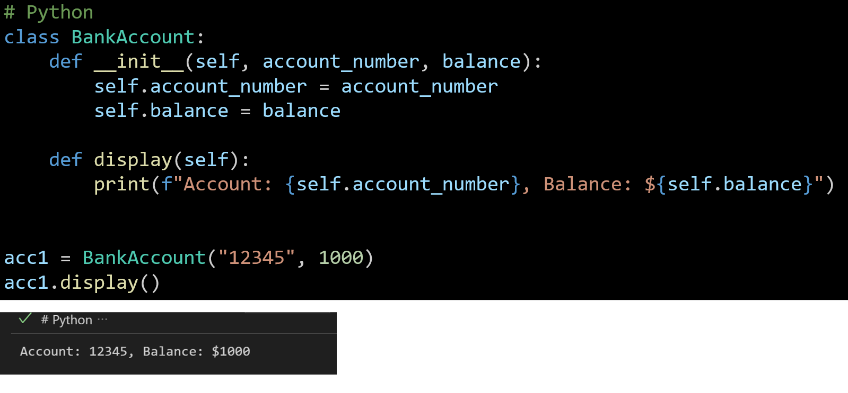
Python Example 1: Creating a BankAccount Class (Objects = Data + Actions)

Slide 7
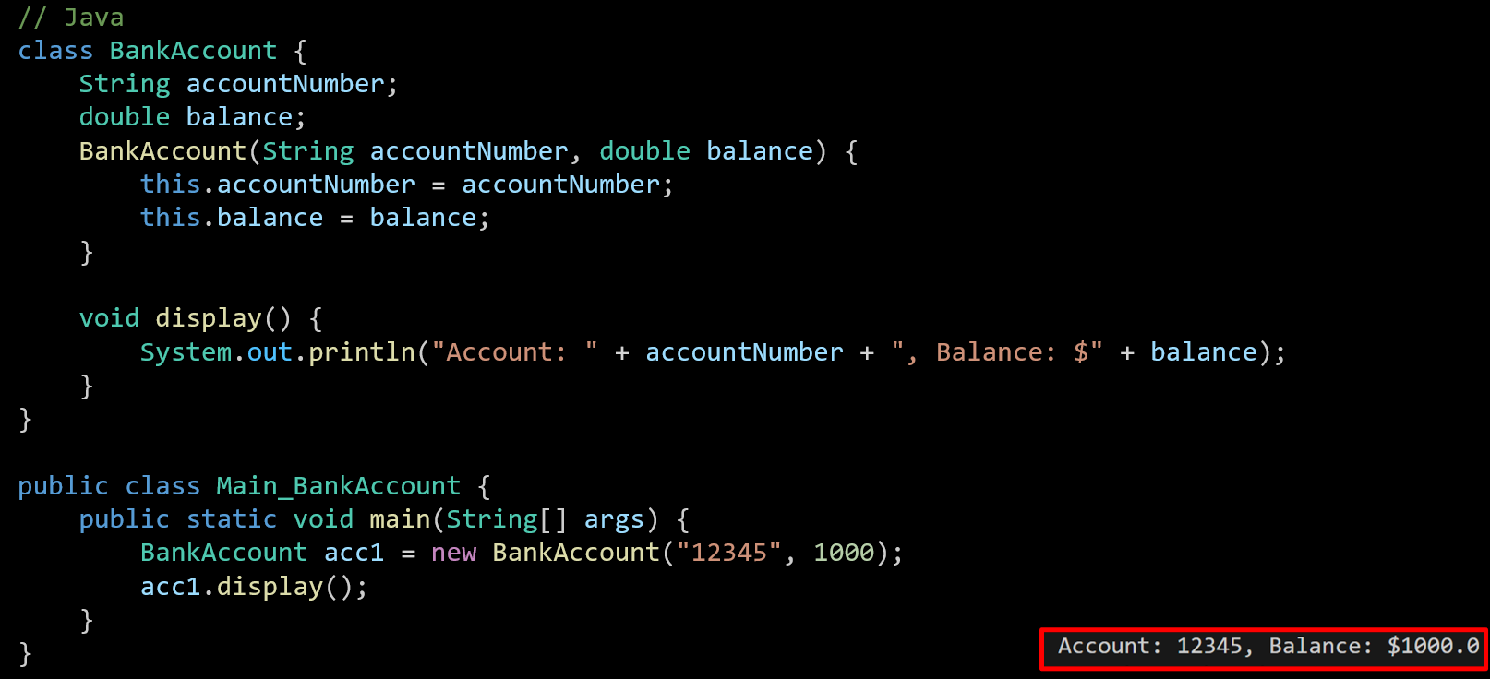
Java Example 1: Creating a BankAccount Class (Data + Actions Together)

Slide 8
Encapsulation
Idea: Keep data and actions together, but hide sensitive details. Only allow safe access through getters and setters.
Java: use private, public, protected.
Python: no strict rule → but _name means “for internal use”.
Analogy (Australia): Like an ATM → you don’t see the whole bank system, only your balance.

Slide 9
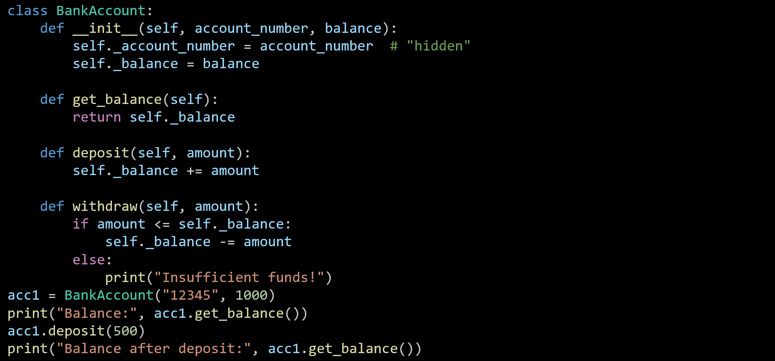
Python Example 2: Encapsulation in BankAccount (Hiding Data with Getters & Setters)
Fields made “hidden” with underscore prefix:
was self.account_number
was self.balance
Removed the direct display() method

Slide 10
Python Example 2: Encapsulation in BankAccount (Hiding Data with Getters & Setters)
Added encapsulation methods to safely access and update balance:
New

Slide 11
Python Example 2: Encapsulation in BankAccount (Hiding Data with Getters & Setters)
Usage updated:
Original: acc1.display()
New:
Python Example 1 → Objects = Data + Actions.
Python Example 2 → Encapsulation = Hide sensitive fields, use getters & setters for control.

Slide 12
Java Example 2: Encapsulation in BankAccount (Using Private Fields and Getters/Setters)
class BankAccount {
// Fields are private (hidden)
private String accountNumber;
private double balance;
// Constructor
BankAccount(String accountNumber, double balance) {
this.accountNumber = accountNumber;
this.balance = balance;
}
// Getter
public double getBalance() {
return balance;
}
// Deposit method (controlled update)
public void deposit(double amount) {
balance += amount;
}
// Withdraw method (controlled update)
public void withdraw(double amount) {
if (amount <= balance) {
balance -= amount;
} else {
System.out.println("Insufficient funds!");
}
}
}
Fields hidden with private:
Getter & setters (methods) added instead of direct access.

Slide 13
Java Example 2: Encapsulation in BankAccount (Using Private Fields and Getters/Setters)
public class Main {
public static void main(String[] args) {
BankAccount acc1 = new BankAccount("12345", 1000);
System.out.println("Balance: " + acc1.getBalance());
acc1.deposit(500);
System.out.println("Balance after deposit: " + acc1.getBalance());
}
}
Usage Updated:

Slide 14
Java Example 2: Encapsulation in BankAccount (Using Private Fields and Getters/Setters)
class BankAccount {
// Fields are private (hidden)
private String accountNumber;
private double balance;
// Constructor
BankAccount(String accountNumber, double balance) {
this.accountNumber = accountNumber;
this.balance = balance;
}
// Getter
public double getBalance() {
return balance;
}
// Deposit method (controlled update)
public void deposit(double amount) {
balance += amount;
}
// Withdraw method (controlled update)
public void withdraw(double amount) {
if (amount <= balance) {
balance -= amount;
} else {
System.out.println("Insufficient funds!");
}
}
}
Java Example 1 = Data + Actions.
Java Example 2 = Encapsulation (hiding sensitive fields + getters/setters).

Slide 15

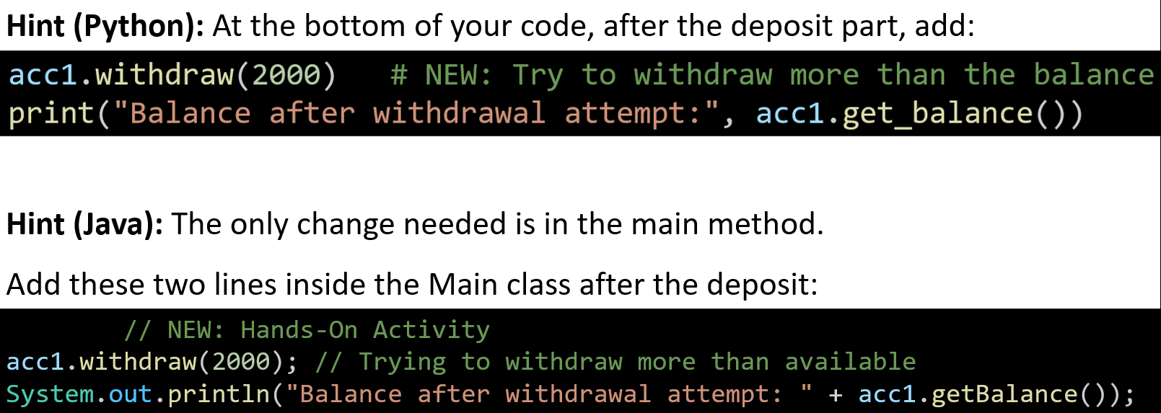
Hands-On Activity 1 - Python: Try calling withdraw(2000) and see how the program prevents overdrawing.

Slide 16
Inheritance
Idea: A child class can reuse code from a parent class.
Parent = Superclass
Child = Subclass
Analogy (Australia): A Student Opal card gets all the travel features of a normal Opal card, plus a concession discount.

Slide 17
Python Example 3: Inheritance with SavingsAccount (Child Reuses Parent Code)
To keep code simpler and focus on inheritance:
We removed withdraw() method
def withdraw(self, amount):
if amount <= self._balance:
self._balance -= amount
else:
print("Insufficient funds!")
class BankAccount:
def __init__(self, account_number, balance):
self._account_number = account_number
self._balance = balance
def deposit(self, amount):
self._balance += amount
def get_balance(self):
return self._balance
# Child class inherits BankAccount
class SavingsAccount(BankAccount):
def __init__(self, account_number, balance, interest_rate):
super().__init__(account_number, balance)
self.interest_rate = interest_rate
def add_interest(self):
self._balance += self._balance * self.interest_rate
acc1 = SavingsAccount("12345", 1000, 0.05)
acc1.add_interest()
print("Balance with interest:", acc1.get_balance())

Slide 18
Python Example 3: Inheritance with SavingsAccount (Child Reuses Parent Code)
class BankAccount:
def __init__(self, account_number, balance):
self._account_number = account_number
self._balance = balance
def deposit(self, amount):
self._balance += amount
def get_balance(self):
return self._balance
# Child class inherits BankAccount
class SavingsAccount(BankAccount):
def __init__(self, account_number, balance, interest_rate):
super().__init__(account_number, balance)
self.interest_rate = interest_rate
def add_interest(self):
self._balance += self._balance * self.interest_rate
acc1 = SavingsAccount("12345", 1000, 0.05)
acc1.add_interest()
print("Balance with interest:", acc1.get_balance())
We kept encapsulation (hidden fields _account_number, _balance, controlled access via deposit() and get_balance()).

Slide 19
Python Example 3: Inheritance with SavingsAccount (Child Reuses Parent Code)
class BankAccount:
def __init__(self, account_number, balance):
self._account_number = account_number
self._balance = balance
def deposit(self, amount):
self._balance += amount
def get_balance(self):
return self._balance
# Child class inherits BankAccount
class SavingsAccount(BankAccount):
def __init__(self, account_number, balance, interest_rate):
super().__init__(account_number, balance)
self.interest_rate = interest_rate
def add_interest(self):
self._balance += self._balance * self.interest_rate
acc1 = SavingsAccount("12345", 1000, 0.05)
acc1.add_interest()
print("Balance with interest:", acc1.get_balance())
Additions in Example 3:
New Child Class (SavingsAccount) inherits from BankAccount:

Slide 20
Python Example 3: Inheritance with SavingsAccount (Child Reuses Parent Code)
class BankAccount:
def __init__(self, account_number, balance):
self._account_number = account_number
self._balance = balance
def deposit(self, amount):
self._balance += amount
def get_balance(self):
return self._balance
# Child class inherits BankAccount
class SavingsAccount(BankAccount):
def __init__(self, account_number, balance, interest_rate):
super().__init__(account_number, balance) # reuses parent init
self.interest_rate = interest_rate # adds new field
def add_interest(self):
self._balance += self._balance * self.interest_rate
acc1 = SavingsAccount("12345", 1000, 0.05)
acc1.add_interest()
print("Balance with interest:", acc1.get_balance())
Child constructor calls parent constructor using super():

Slide 21
Python Example 3: Inheritance with SavingsAccount (Child Reuses Parent Code)
class BankAccount:
def __init__(self, account_number, balance):
self._account_number = account_number
self._balance = balance
def deposit(self, amount):
self._balance += amount
def get_balance(self):
return self._balance
# Child class inherits BankAccount
class SavingsAccount(BankAccount):
def __init__(self, account_number, balance, interest_rate):
super().__init__(account_number, balance)
self.interest_rate = interest_rate
def add_interest(self):
self._balance += self._balance * self.interest_rate
acc1 = SavingsAccount("12345", 1000, 0.05)
acc1.add_interest()
print("Balance with interest:", acc1.get_balance())
New method in child class:

Slide 22
Python Example 3: Inheritance with SavingsAccount (Child Reuses Parent Code)
class BankAccount:
def __init__(self, account_number, balance):
self._account_number = account_number
self._balance = balance
def deposit(self, amount):
self._balance += amount
def get_balance(self):
return self._balance
# Child class inherits BankAccount
class SavingsAccount(BankAccount):
def __init__(self, account_number, balance, interest_rate):
super().__init__(account_number, balance)
self.interest_rate = interest_rate
def add_interest(self):
self._balance += self._balance * self.interest_rate
acc1 = SavingsAccount("12345", 1000, 0.05) # Child class used
acc1.add_interest() # New child method
print("Balance with interest:", acc1.get_balance())
Changes in the main/test code:
Example 2:
acc1 = BankAccount("12345", 1000)
acc1.deposit(500)
print("Balance after deposit:", acc1.get_balance())

Slide 23
Python Example 3: Inheritance with SavingsAccount (Child Reuses Parent Code)
class BankAccount:
def __init__(self, account_number, balance):
self._account_number = account_number
self._balance = balance
def deposit(self, amount):
self._balance += amount
def get_balance(self):
return self._balance
# Child class inherits BankAccount
class SavingsAccount(BankAccount):
def __init__(self, account_number, balance, interest_rate):
super().__init__(account_number, balance)
self.interest_rate = interest_rate
def add_interest(self):
self._balance += self._balance * self.interest_rate
acc1 = SavingsAccount("12345", 1000, 0.05) # Child class used
acc1.add_interest() # New child method
print("Balance with interest:", acc1.get_balance())
Example 2 (Encapsulation): Hide data, control access with getters/setters, add withdraw check.
Example 3 (Encapsulation + Inheritance): Reuses parent (BankAccount), creates child (SavingsAccount) that adds new behavior (add_interest).

Slide 24
Java Example 3: Inheritance with SavingsAccount (Child Reuses Parent Code)
class BankAccount {
protected String accountNumber;
protected double balance;
BankAccount(String accountNumber, double balance) {
this.accountNumber = accountNumber;
this.balance = balance;
}
public void deposit(double amount) {
balance += amount;
}
public double getBalance() {
return balance;
}
}
// Child class
class SavingsAccount extends BankAccount {
private double interestRate;
SavingsAccount(String accountNumber, double balance, double interestRate) {
super(accountNumber, balance);
this.interestRate = interestRate;
}
public void addInterest() {
balance += balance * interestRate;
}
}
Changes in BankAccount
Field visibility
// Example 2
private String accountNumber; // hidden
private double balance;
// Example 3
protected String accountNumber;
protected double balance;
Changed from private → protected so child classes can access the fields.

Slide 25
Java Example 3: Inheritance with SavingsAccount (Child Reuses Parent Code)
class BankAccount {
protected String accountNumber;
protected double balance;
BankAccount(String accountNumber, double balance) {
this.accountNumber = accountNumber;
this.balance = balance;
}
public void deposit(double amount) {
balance += amount;
}
public double getBalance() {
return balance;
}
}
// Child class
class SavingsAccount extends BankAccount {
private double interestRate;
SavingsAccount(String accountNumber, double balance, double interestRate) {
super(accountNumber, balance);
this.interestRate = interestRate;
}
public void addInterest() {
balance += balance * interestRate;
}
}
Removed withdraw() method
// Example 2 had:
public void withdraw(double amount) {
if (amount <= balance) {
balance -= amount;
} else {
System.out.println("Insufficient funds!");
}
}
Not present in Example 3, to keep focus on inheritance.

Slide 26
Java Example 3: Inheritance with SavingsAccount (Child Reuses Parent Code)
class BankAccount {
protected String accountNumber;
protected double balance;
BankAccount(String accountNumber, double balance) {
this.accountNumber = accountNumber;
this.balance = balance;
}
public void deposit(double amount) {
balance += amount;
}
public double getBalance() {
return balance;
}
}
// Child class
class SavingsAccount extends BankAccount {
private double interestRate;
SavingsAccount(String accountNumber, double balance, double interestRate) {
super(accountNumber, balance);
this.interestRate = interestRate;
}
public void addInterest() {
balance += balance * interestRate;
}
}
Additions in Example 3
New Child Class SavingsAccount extends BankAccount:

Slide 27
Java Example 3: Inheritance with SavingsAccount (Child Reuses Parent Code)
class BankAccount {
protected String accountNumber;
protected double balance;
BankAccount(String accountNumber, double balance) {
this.accountNumber = accountNumber;
this.balance = balance;
}
public void deposit(double amount) {
balance += amount;
}
public double getBalance() {
return balance;
}
}
// Child class
class SavingsAccount extends BankAccount {
private double interestRate;
SavingsAccount(String accountNumber, double balance, double interestRate) {
super(accountNumber, balance);
this.interestRate = interestRate;
}
public void addInterest() {
balance += balance * interestRate;
}
}
Child constructor calls parent constructor using super():

Slide 28
Java Example 3: Inheritance with SavingsAccount (Child Reuses Parent Code)
class BankAccount {
protected String accountNumber;
protected double balance;
BankAccount(String accountNumber, double balance) {
this.accountNumber = accountNumber;
this.balance = balance;
}
public void deposit(double amount) {
balance += amount;
}
public double getBalance() {
return balance;
}
}
// Child class
class SavingsAccount extends BankAccount {
private double interestRate;
SavingsAccount(String accountNumber, double balance, double interestRate) {
super(accountNumber, balance);
this.interestRate = interestRate;
}
public void addInterest() {
balance += balance * interestRate;
}
}
New method in child class:

Slide 29
Java Example 3: Inheritance with SavingsAccount (Child Reuses Parent Code)
public class Main {
public static void main(String[] args) {
SavingsAccount acc1 = new SavingsAccount("12345", 1000, 0.05);
acc1.addInterest();
System.out.println("Balance with interest: " + acc1.getBalance());
}
}
Changes in Main
Example 2 (using parent only):
BankAccount acc1 = new BankAccount("12345", 1000);
acc1.deposit(500);
System.out.println("Balance after deposit: " + acc1.getBalance());
Example 3 (using child class):

Slide 30
Java Example 3: Inheritance with SavingsAccount (Child Reuses Parent Code)
public class Main {
public static void main(String[] args) {
SavingsAccount acc1 = new SavingsAccount("12345", 1000, 0.05);
acc1.addInterest();
System.out.println("Balance with interest: " + acc1.getBalance());
}
}
Example 2 (Encapsulation): Focus on hiding fields with private, controlling access via getters/setters, and preventing overdrawing with withdraw().
Example 3 (Encapsulation + Inheritance): Reuses parent BankAccount via extends, makes fields accessible with protected, adds a child class SavingsAccount with new behavior (addInterest).

Slide 31
Hands-On Activity 2 (Python): Create a CheckingAccount Subclass with Overdraft
Python Activity Instructions
Task:
Add another subclass CheckingAccount that allows a one-time overdraft of $100.
Hint for Python
Define class CheckingAccount(BankAccount):
Use super().__init__(account_number, balance) in the constructor.
Add a method withdraw(amount) that:
Allows withdrawal if amount <= balance + 100.
Deducts from balance if allowed.
Prints a message if overdraft is exceeded.

Slide 32
Hands-On Activity 2 (Java): Create a CheckingAccount Subclass with Overdraft
Java Activity Instructions
Task: Add another subclass CheckingAccount that allows a one-time overdraft of $100.
Hint for Java
Define class CheckingAccount extends BankAccount { ... }
Create a constructor that calls super(accountNumber, balance).
Add a method withdraw(double amount) that:
Allows withdrawal if amount <= balance + 100.
Deducts from balance if allowed.
Prints "Overdraft limit exceeded!" otherwise.

Slide 33
Polymorphism
Idea: One parent type can have many child forms.
Same method name → but each child does it in its own way.
Analogy (Australia): A vehicle in Sydney transport could be a Bus, Train, or Ferry → all can move(), but each moves differently.

Slide 34
Python Example 4: Polymorphism with BankAccount (Same Method, Different Behaviour)
Change & Explanation:
Removed constructor (__init__), deposit(), and get_balance() from example 3→ these were useful for encapsulation but not needed to demonstrate polymorphism.
Added a placeholder withdraw() method → acts as a common parent method to be overridden by child classes.
This sets the stage for polymorphism: same method name, different child behaviours.
class BankAccount:
def withdraw(self, amount):
pass # parent method placeholder
class SavingsAccount(BankAccount):
def __init__(self, balance):
self._balance = balance
def withdraw(self, amount):
if amount <= self._balance:
self._balance -= amount
print("Savings withdrawal successful")
else:
print("Insufficient funds in savings!")
class CheckingAccount(BankAccount):
def __init__(self, balance):
self._balance = balance
def withdraw(self, amount):
self._balance -= amount
print("Checking withdrawal (may go negative).")

Slide 35
Python Example 4: Polymorphism with BankAccount (Same Method, Different Behaviour)
class BankAccount:
def withdraw(self, amount):
pass # parent method placeholder
class SavingsAccount(BankAccount):
def __init__(self, balance):
self._balance = balance
def withdraw(self, amount):
if amount <= self._balance:
self._balance -= amount
print("Savings withdrawal successful")
else:
print("Insufficient funds in savings!")
class CheckingAccount(BankAccount):
def __init__(self, balance):
self._balance = balance
def withdraw(self, amount):
self._balance -= amount
print("Checking withdrawal (may go negative).")
SavingsAccount class
In Example 3:
Constructor with super().__init__ to reuse parent fields.
Extra method add_interest() for interest calculation.

Slide 36
Python Example 4: Polymorphism with BankAccount (Same Method, Different Behaviour)
Change & Explanation:
Constructor simplified (no account_number, no super() call) → keeps focus only on balance for withdraw testing.
add_interest() removed.
Overrides the withdraw() method → savings account blocks overdrawing.
Shows encapsulation (hidden _balance) + inheritance (extends BankAccount) + polymorphism (its own withdraw() logic).
class BankAccount:
def withdraw(self, amount):
pass # parent method placeholder
class SavingsAccount(BankAccount):
def __init__(self, balance):
self._balance = balance
def withdraw(self, amount):
if amount <= self._balance:
self._balance -= amount
print("Savings withdrawal successful")
else:
print("Insufficient funds in savings!")
class CheckingAccount(BankAccount):
def __init__(self, balance):
self._balance = balance
def withdraw(self, amount):
self._balance -= amount
print("Checking withdrawal (may go negative).")

Slide 37
Python Example 4: Polymorphism with BankAccount (Same Method, Different Behaviour)
3. CheckingAccount class
New in Example 4:
New subclass to contrast with SavingsAccount.
withdraw() allows overdraft (balance can go negative).
Demonstrates polymorphism by having the same method name as SavingsAccount, but different behaviour.
class BankAccount:
def withdraw(self, amount):
pass # parent method placeholder
class SavingsAccount(BankAccount):
def __init__(self, balance):
self._balance = balance
def withdraw(self, amount):
if amount <= self._balance:
self._balance -= amount
print("Savings withdrawal successful")
else:
print("Insufficient funds in savings!")
class CheckingAccount(BankAccount):
def __init__(self, balance):
self._balance = balance
def withdraw(self, amount):
self._balance -= amount
print("Checking withdrawal (may go negative).")

Slide 38
Python Example 4: Polymorphism with BankAccount (Same Method, Different Behaviour)
# Polymorphism in action
accounts = [SavingsAccount(500), CheckingAccount(500)]
for acc in accounts:
acc.withdraw(600) # different behaviour, same method
4. Main / Test Code
Example 3:
acc1 = SavingsAccount("12345", 1000, 0.05)
acc1.add_interest()
print("Balance with interest:", acc1.get_balance())
Change & Explanation:
Instead of testing just one object, Example 4 tests multiple account types in a list.

Slide 39
Python Example 4: Polymorphism with BankAccount (Same Method, Different Behaviour)
# Polymorphism in action
accounts = [SavingsAccount(500), CheckingAccount(500)]
for acc in accounts:
acc.withdraw(600) # different behaviour, same method
Calls the same method withdraw() on both.
Output differs depending on the object type → this is polymorphism in action.

Slide 40
Python Example 4: Polymorphism with BankAccount (Same Method, Different Behaviour)
# Polymorphism in action
accounts = [SavingsAccount(500), CheckingAccount(500)]
for acc in accounts:
acc.withdraw(600) # different behaviour, same method
Does Example 4 cover all OOP concepts?
Encapsulation: Yes → _balance is kept “internal”.
Inheritance: Yes → SavingsAccount and CheckingAccount inherit from BankAccount.
Polymorphism: Yes → both subclasses override the same method withdraw(), but with different behaviours.

Slide 41
Python Example 4: Polymorphism with BankAccount (Same Method, Different Behaviour)
# Polymorphism in action
accounts = [SavingsAccount(500), CheckingAccount(500)]
for acc in accounts:
acc.withdraw(600) # different behaviour, same method
Example 3: Encapsulation + Inheritance.
Example 4: Builds further → Encapsulation + Inheritance + Polymorphism.

Slide 42
Java Example 4: Polymorphism with BankAccount (Same Method, Different Behaviour)
BankAccount class
Changes:
Removed fields (accountNumber, balance) and their constructor.
Removed deposit() and getBalance().
Added a generic withdraw() method as a placeholder → this allows child classes to override it.
class BankAccount {
public void withdraw(double amount) {
System.out.println("Generic withdrawal");
}
}
class SavingsAccount extends BankAccount {
private double balance = 500;
@Override
public void withdraw(double amount) {
if (amount <= balance) {
balance -= amount;
System.out.println("Savings withdrawal successful");
} else {
System.out.println("Insufficient funds in savings!");
}
}
} class CheckingAccount extends BankAccount {
private double balance = 500;
@Override
public void withdraw(double amount) {
balance -= amount; // may go negative
System.out.println("Checking withdrawal (may go negative).");
}
}

Slide 43
Java Example 4: Polymorphism with BankAccount (Same Method, Different Behaviour)
class BankAccount {
public void withdraw(double amount) {
System.out.println("Generic withdrawal");
}
}
class SavingsAccount extends BankAccount {
private double balance = 500;
@Override
public void withdraw(double amount) {
if (amount <= balance) {
balance -= amount;
System.out.println("Savings withdrawal successful");
} else {
System.out.println("Insufficient funds in savings!");
}
}
} class CheckingAccount extends BankAccount {
private double balance = 500;
@Override
public void withdraw(double amount) {
balance -= amount; // may go negative
System.out.println("Checking withdrawal (may go negative).");
}
}
Reason: In polymorphism, the parent only defines the common interface (method name), while child classes provide different behaviours.

Slide 44
Java Example 4: Polymorphism with BankAccount (Same Method, Different Behaviour)
class BankAccount {
public void withdraw(double amount) {
System.out.println("Generic withdrawal");
}
}
class SavingsAccount extends BankAccount {
private double balance = 500;
@Override
public void withdraw(double amount) {
if (amount <= balance) {
balance -= amount;
System.out.println("Savings withdrawal successful");
} else {
System.out.println("Insufficient funds in savings!");
}
}
} class CheckingAccount extends BankAccount {
private double balance = 500;
@Override
public void withdraw(double amount) {
balance -= amount; // may go negative
System.out.println("Checking withdrawal (may go negative).");
}
}
2. SavingsAccount class
Changes:
Removed constructor and interest-related code (interestRate, addInterest()).
Added its own balance field (starting at 500).
Overrides withdraw() with stricter rules (no overdraft allowed).

Slide 45
Java Example 4: Polymorphism with BankAccount (Same Method, Different Behaviour)
class BankAccount {
public void withdraw(double amount) {
System.out.println("Generic withdrawal");
}
}
class SavingsAccount extends BankAccount {
private double balance = 500;
@Override
public void withdraw(double amount) {
if (amount <= balance) {
balance -= amount;
System.out.println("Savings withdrawal successful");
} else {
System.out.println("Insufficient funds in savings!");
}
}
} class CheckingAccount extends BankAccount {
private double balance = 500;
@Override
public void withdraw(double amount) {
balance -= amount; // may go negative
System.out.println("Checking withdrawal (may go negative).");
}
}
Reason: Shifts focus from interest to withdrawal behaviour. This demonstrates method overriding, a key part of polymorphism.

Slide 46
Java Example 4: Polymorphism with BankAccount (Same Method, Different Behaviour)
class BankAccount {
public void withdraw(double amount) {
System.out.println("Generic withdrawal");
}
}
class SavingsAccount extends BankAccount {
private double balance = 500;
@Override
public void withdraw(double amount) {
if (amount <= balance) {
balance -= amount;
System.out.println("Savings withdrawal successful");
} else {
System.out.println("Insufficient funds in savings!");
}
}
} class CheckingAccount extends BankAccount {
private double balance = 500;
@Override
public void withdraw(double amount) {
balance -= amount; // may go negative
System.out.println("Checking withdrawal (may go negative).");
}
}
3. CheckingAccount class
Example 3
Not present.
Addition:
Introduced a new child class CheckingAccount.
Overrides withdraw() differently → allows overdraft (balance may go negative).

Slide 47
Java Example 4: Polymorphism with BankAccount (Same Method, Different Behaviour)
class BankAccount {
public void withdraw(double amount) {
System.out.println("Generic withdrawal");
}
}
class SavingsAccount extends BankAccount {
private double balance = 500;
@Override
public void withdraw(double amount) {
if (amount <= balance) {
balance -= amount;
System.out.println("Savings withdrawal successful");
} else {
System.out.println("Insufficient funds in savings!");
}
}
} class CheckingAccount extends BankAccount {
private double balance = 500;
@Override
public void withdraw(double amount) {
balance -= amount; // may go negative
System.out.println("Checking withdrawal (may go negative).");
}
}
Reason: Having at least two subclasses makes polymorphism visible: same method name, different results.

Slide 48
Java Example 4: Polymorphism with BankAccount (Same Method, Different Behaviour)
public class Main {
public static void main(String[] args) {
BankAccount[] accounts = {new SavingsAccount(), new CheckingAccount()};
for (BankAccount acc : accounts) {
acc.withdraw(600); // different outcomes
}
}
}
4. Main Method:
Changes:
Instead of working with one SavingsAccount, Example 4 creates an array of different account types.
Calls the same method (withdraw()) on both objects in a loop.

Slide 49
Java Example 4: Polymorphism with BankAccount (Same Method, Different Behaviour)
public class Main {
public static void main(String[] args) {
BankAccount[] accounts = {new SavingsAccount(), new CheckingAccount()};
for (BankAccount acc : accounts) {
acc.withdraw(600); // different outcomes
}
}
}
Reason: This demonstrates polymorphism in action — the method call depends on the object type, not the variable type.

Slide 50
Java Example 4: Polymorphism with BankAccount (Same Method, Different Behaviour)
public class Main {
public static void main(String[] args) {
BankAccount[] accounts = {new SavingsAccount(), new CheckingAccount()};
for (BankAccount acc : accounts) {
acc.withdraw(600); // different outcomes
}
}
}
Does Example 4 include Encapsulation, Inheritance, and Polymorphism?
Encapsulation: Yes — balance is still private in child classes.
Inheritance: Yes — both SavingsAccount and CheckingAccount extend BankAccount.
Polymorphism: Yes — withdraw() behaves differently depending on whether the object is a savings or checking account.

Slide 51
Java Example 4: Polymorphism with BankAccount (Same Method, Different Behaviour)
public class Main {
public static void main(String[] args) {
BankAccount[] accounts = {new SavingsAccount(), new CheckingAccount()};
for (BankAccount acc : accounts) {
acc.withdraw(600); // different outcomes
}
}
}
Summary:
Example 3: Encapsulation + Inheritance (focus on reusing parent code, interest calculation).
Example 4: Encapsulation + Inheritance + Polymorphism (focus on overriding the same method in different subclasses).

Slide 52
Hands-On Activity 3 (Python): Adding a get_balance() Method (Encapsulation + Polymorphism)
Task: Add a get_balance() method to both SavingsAccount and CheckingAccount classes.
Implement the method so it returns the current balance.
After performing withdrawals, call get_balance() for each account.
Print the balances to verify the results (Savings should block overdraft, Checking may go negative).

Slide 53
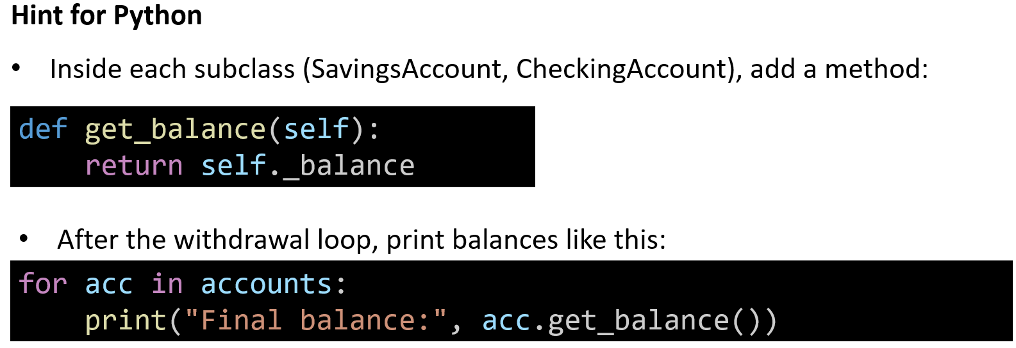
Hands-On Activity 3 (Python): Adding a get_balance() Method (Encapsulation + Polymorphism)

Slide 54
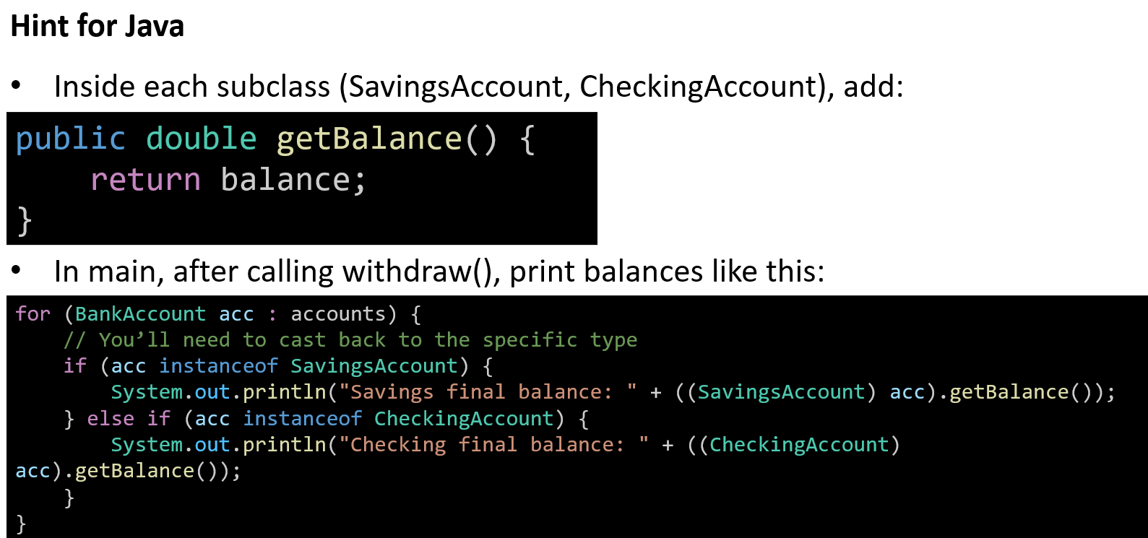
Hands-On Activity 3 (Java): Adding a get_balance() Method (Encapsulation + Polymorphism)

Slide 55
Hands-On Activity 3 (Java): Adding a get_balance() Method (Encapsulation + Polymorphism)
This task reinforces:
Encapsulation → balance is private/hidden, accessed only through a getter.
Polymorphism → different withdraw behaviours still lead to correct balance reporting.

Slide 56
Abstraction
Idea: Show what to do, hide how it’s done.
Use an abstract class or interface → it defines methods, but no details.
Child classes then provide the actual code.
Analogy (Australia): Driving a car → you just use the steering wheel and pedals, but you don’t see how the engine works inside.

Slide 57
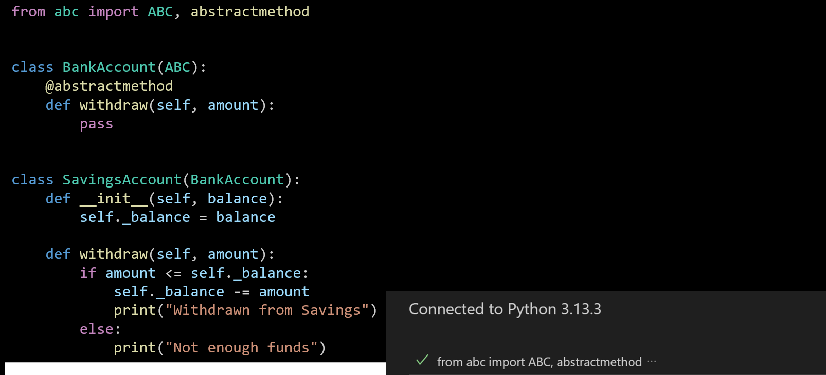
Python Example 5: Abstraction with BankAccount (Using Abstract Class)
1. Parent Class
Example 4:
class BankAccount:
def withdraw(self, amount):
pass # parent method placeholder
→ Regular class, withdraw() is just a placeholder but can still be called directly.

Slide 58
Python Example 5: Abstraction with BankAccount (Using Abstract Class)
Example 5: → Becomes an abstract class using ABC and @abstractmethod. → Cannot create objects of BankAccount directly.
Why: Abstraction forces child classes to provide their own withdraw() method.

Slide 59
Python Example 5: Abstraction with BankAccount (Using Abstract Class)
2. Child Classes
Example 4: Had two child classes (SavingsAccount, CheckingAccount) that overrode withdraw().
Example 5: Only defines one child class (SavingsAccount) so far.
Why: Focus is on showing how abstraction works, not polymorphism yet.

Slide 60
Python Example 5: Abstraction with BankAccount (Using Abstract Class)
3. Method Behaviour
Example 4 (SavingsAccount):
print("Savings withdrawal successful")
Example 5 (SavingsAccount):
print("Withdrawn from Savings")
Simpler wording, but both show that the child must provide its own logic.

Slide 61
Python Example 5: Abstraction with BankAccount (Using Abstract Class)
4. Usage / Execution
Example 4: Created a list of different account types → showed polymorphism in action.
Example 5: Only defines the abstract structure and one subclass → focuses on abstraction, not polymorphic testing.

Slide 62
Python Example 5: Abstraction with BankAccount (Using Abstract Class)
Summary
Example 4 (Polymorphism): Same method name (withdraw) → different behaviours depending on account type.
Example 5 (Abstraction): Parent class only defines what must exist (withdraw) but hides how it works. Child classes must implement the details.

Slide 63
Java Example 5: Abstraction with BankAccount (Using Abstract Class)
1. Parent Class
Example 4:
class BankAccount {
public void withdraw(double amount) {
System.out.println("Generic withdrawal");
}
}
→ Regular class, withdraw() has a default behaviour.
abstract class BankAccount {
public abstract void withdraw(double amount);
}
class SavingsAccount extends BankAccount {
private double balance = 1000;
@Override
public void withdraw(double amount) {
if (amount <= balance) {
balance -= amount;
System.out.println("Withdrawn from Savings");
} else {
System.out.println("Not enough funds");
}
}
}

Slide 64
Java Example 5: Abstraction with BankAccount (Using Abstract Class)
Example 5:
→ Now declared abstract. → withdraw() is an abstract method → no body.
Why: Abstract parent enforces that all subclasses must implement withdraw().
abstract class BankAccount {
public abstract void withdraw(double amount);
}
class SavingsAccount extends BankAccount {
private double balance = 1000;
@Override
public void withdraw(double amount) {
if (amount <= balance) {
balance -= amount;
System.out.println("Withdrawn from Savings");
} else {
System.out.println("Not enough funds");
}
}
}

Slide 65
Java Example 5: Abstraction with BankAccount (Using Abstract Class)
abstract class BankAccount {
public abstract void withdraw(double amount);
}
class SavingsAccount extends BankAccount {
private double balance = 1000;
@Override
public void withdraw(double amount) {
if (amount <= balance) {
balance -= amount;
System.out.println("Withdrawn from Savings");
} else {
System.out.println("Not enough funds");
}
}
}
2. Child Classes
Example 4:
- SavingsAccount (with withdraw logic)
- CheckingAccount (with different withdraw logic)
Example 5:
- Only SavingsAccount remains.
- Implements the required withdraw() method.
Why: Focus shifts to showing abstraction, not polymorphism.

Slide 66
Java Example 5: Abstraction with BankAccount (Using Abstract Class)
3. Main Method
Example 4:
public static void main(String[] args) {
BankAccount[] accounts = {new SavingsAccount(), new CheckingAccount()};
for (BankAccount acc : accounts) {
acc.withdraw(600); // different outcomes
}
}
→ Tests polymorphism across multiple account types.
Example 5: → No main class provided yet. → Example just demonstrates that BankAccount is abstract and must be extended.
abstract class BankAccount {
public abstract void withdraw(double amount);
}
class SavingsAccount extends BankAccount {
private double balance = 1000;
@Override
public void withdraw(double amount) {
if (amount <= balance) {
balance -= amount;
System.out.println("Withdrawn from Savings");
} else {
System.out.println("Not enough funds");
}
}
}

Slide 67
Java Example 5: Abstraction with BankAccount (Using Abstract Class)
Does Example 5 (Python) cover all OOP concepts?
Encapsulation: Not covered (balance is directly stored in _balance, but no get_balance() or other controlled access method).
Inheritance: Covered (child class SavingsAccount inherits from BankAccount).
Polymorphism: Not shown (only one subclass, so no “same method, different behaviours”).
Abstraction: Covered (abstract class BankAccount with abstract method withdraw).
abstract class BankAccount {
public abstract void withdraw(double amount);
}
class SavingsAccount extends BankAccount {
private double balance = 1000;
@Override
public void withdraw(double amount) {
if (amount <= balance) {
balance -= amount;
System.out.println("Withdrawn from Savings");
} else {
System.out.println("Not enough funds");
}
}
}

Slide 68
Java Example 5: Abstraction with BankAccount (Using Abstract Class)
Summary
Python Example 5: Focuses purely on abstraction.
Missing encapsulation (no getters/setters).
Missing polymorphism (needs multiple subclasses with different withdraw() behaviours).
Java Example 5: Same as Python — shows abstraction, but does not yet demonstrate encapsulation or polymorphism.
abstract class BankAccount {
public abstract void withdraw(double amount);
}
class SavingsAccount extends BankAccount {
private double balance = 1000;
@Override
public void withdraw(double amount) {
if (amount <= balance) {
balance -= amount;
System.out.println("Withdrawn from Savings");
} else {
System.out.println("Not enough funds");
}
}
}

Slide 69
Hands-On Activity 4 (Python): Creating a BusinessAccount Subclass (Abstraction + Polymorphism)
Create another subclass BusinessAccount that inherits from BankAccount and must implement the withdraw() method.
Add your own logic for how a business account should handle withdrawals (e.g., allow larger overdrafts, block certain withdrawals, or simply deduct the balance).
Then, test the new BusinessAccount by creating an object and calling withdraw()

Slide 70
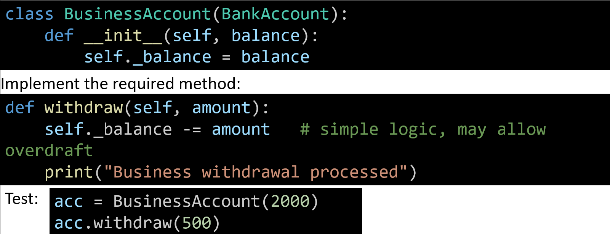
Hands-On Activity 4 (Python): Creating a BusinessAccount Subclass (Abstraction + Polymorphism)
Hint for Python
Define a new class extending the abstract parent:

Slide 71
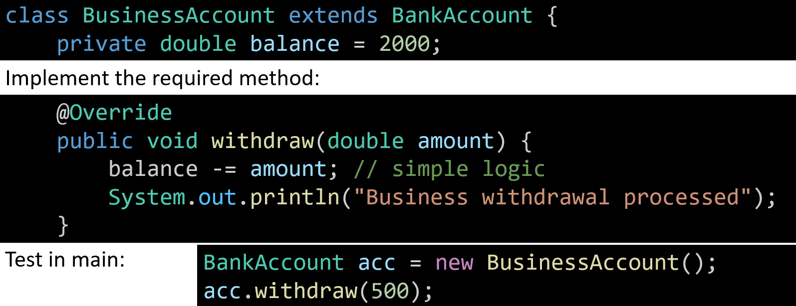
Hands-On Activity 4 (Python): Creating a BusinessAccount Subclass (Abstraction + Polymorphism)
Hint for Java
Define a new subclass:

Slide 72
Hands-On Activity 4 (Python): Creating a BusinessAccount Subclass (Abstraction + Polymorphism)
This reinforces:
Abstraction → subclass must implement the abstract method.
Inheritance → BusinessAccount extends BankAccount.
Polymorphism → withdraw() behaves differently depending on account type.

Slide 73
Python Example 6: Combining All OOP Concepts (Encapsulation, Inheritance, Polymorphism, Abstraction)
from abc import ABC, abstractmethod
# Abstract Parent Class
class BankAccount(ABC):
def __init__(self, balance):
self._balance = balance # Encapsulation (hidden field)
@abstractmethod
def withdraw(self, amount):
pass
def get_balance(self): # Encapsulation (getter)
return self._balance
# Child 1: SavingsAccount
class SavingsAccount(BankAccount):
def withdraw(self, amount):
if amount <= self._balance:
self._balance -= amount
print("Savings withdrawal successful")
else:
print("Not enough funds in savings!")
Abstraction: The parent class BankAccount only defines what must exist (withdraw), but not how it works.

Slide 74
Python Example 6: Combining All OOP Concepts (Encapsulation, Inheritance, Polymorphism, Abstraction)
from abc import ABC, abstractmethod
# Abstract Parent Class
class BankAccount(ABC):
def __init__(self, balance):
self._balance = balance # Encapsulation (hidden field)
@abstractmethod
def withdraw(self, amount):
pass
def get_balance(self): # Encapsulation (getter)
return self._balance
# Child 1: SavingsAccount
class SavingsAccount(BankAccount):
def withdraw(self, amount):
if amount <= self._balance:
self._balance -= amount
print("Savings withdrawal successful")
else:
print("Not enough funds in savings!")
Inheritance: Child classes SavingsAccount and CheckingAccount reuse the parent’s structure.

Slide 75
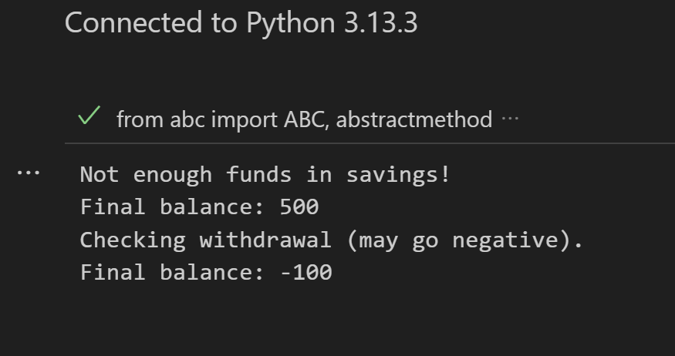
Python Example 6: Combining All OOP Concepts (Encapsulation, Inheritance, Polymorphism, Abstraction)
# Child 2: CheckingAccount
class CheckingAccount(BankAccount):
def withdraw(self, amount):
self._balance -= amount # may go negative
print("Checking withdrawal (may go negative).")
# Polymorphism in action
accounts = [SavingsAccount(500), CheckingAccount(500)]
for acc in accounts:
acc.withdraw(600)
print("Final balance:", acc.get_balance())
In short: We hide details (abstraction + encapsulation), reuse code (inheritance), and allow different behaviours with the same method name (polymorphism).

Slide 76
Python Example 6: Combining All OOP Concepts (Encapsulation, Inheritance, Polymorphism, Abstraction)
from abc import ABC, abstractmethod
# Abstract Parent Class
class BankAccount(ABC):
def __init__(self, balance):
self._balance = balance # Encapsulation (hidden field)
@abstractmethod
def withdraw(self, amount):
pass
def get_balance(self): # Encapsulation (getter)
return self._balance
# Child 1: SavingsAccount
class SavingsAccount(BankAccount):
def withdraw(self, amount):
if amount <= self._balance:
self._balance -= amount
print("Savings withdrawal successful")
else:
print("Not enough funds in savings!")
Encapsulation: The balance is hidden (_balance) and only accessed safely through get_balance().

Slide 77
Python Example 6: Combining All OOP Concepts (Encapsulation, Inheritance, Polymorphism, Abstraction)
from abc import ABC, abstractmethod
# Abstract Parent Class
class BankAccount(ABC):
def __init__(self, balance):
self._balance = balance # Encapsulation (hidden field)
@abstractmethod
def withdraw(self, amount):
pass
def get_balance(self): # Encapsulation (getter)
return self._balance
# Child 1: SavingsAccount
class SavingsAccount(BankAccount):
def withdraw(self, amount):
if amount <= self._balance:
self._balance -= amount
print("Savings withdrawal successful")
else:
print("Not enough funds in savings!")
Polymorphism: Both accounts share the same method name withdraw(), but behave differently —
Savings: blocks overdrafts.
Checking: allows overdrafts.

Slide 78
Python Example 6: Combining All OOP Concepts (Encapsulation, Inheritance, Polymorphism, Abstraction)
# Child 2: CheckingAccount
class CheckingAccount(BankAccount):
def withdraw(self, amount):
self._balance -= amount # may go negative
print("Checking withdrawal (may go negative).")
# Polymorphism in action
accounts = [SavingsAccount(500), CheckingAccount(500)]
for acc in accounts:
acc.withdraw(600)
print("Final balance:", acc.get_balance())
Polymorphism: Both accounts share the same method name withdraw(), but behave differently —
Savings: blocks overdrafts.
Checking: allows overdrafts.

Slide 79
Python Example 6: Combining All OOP Concepts (Encapsulation, Inheritance, Polymorphism, Abstraction)
# Child 2: CheckingAccount
class CheckingAccount(BankAccount):
def withdraw(self, amount):
self._balance -= amount # may go negative
print("Checking withdrawal (may go negative).")
# Polymorphism in action
accounts = [SavingsAccount(500), CheckingAccount(500)]
for acc in accounts:
acc.withdraw(600)
print("Final balance:", acc.get_balance())
In short:
We hide details → abstraction + encapsulation.
We reuse code → inheritance.
We allow different behaviours with the same method name → polymorphism.

Slide 80
Java Example 6: Combining All OOP Concepts (Encapsulation, Inheritance, Polymorphism, Abstraction)
abstract class BankAccount {
protected double balance; // Encapsulation (hidden from outside)
BankAccount(double balance) {
this.balance = balance;
}
public abstract void withdraw(double amount);
public double getBalance() { // Encapsulation (getter)
return balance;
}
}
// Child 1: SavingsAccount
class SavingsAccount extends BankAccount {
SavingsAccount(double balance) {
super(balance);
}
@Override
public void withdraw(double amount) {
if (amount <= balance) {
balance -= amount;
System.out.println("Savings withdrawal successful");
} else {
System.out.println("Not enough funds in savings!");
}
}
}
Abstraction The parent BankAccount is abstract — it defines withdraw() but doesn’t say how it works:

Slide 81
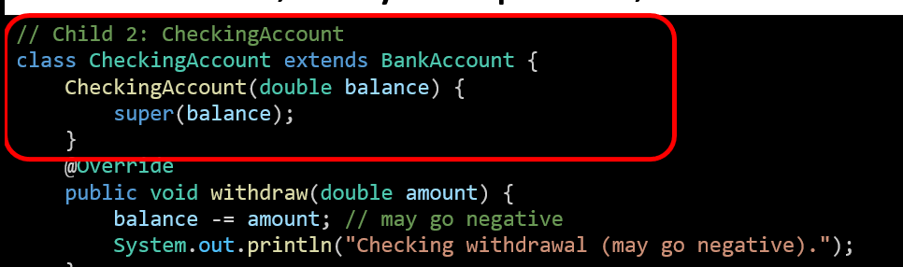
Java Example 6: Combining All OOP Concepts (Encapsulation, Inheritance, Polymorphism, Abstraction)
abstract class BankAccount {
protected double balance; // Encapsulation (hidden from outside)
BankAccount(double balance) {
this.balance = balance;
}
public abstract void withdraw(double amount);
public double getBalance() { // Encapsulation (getter)
return balance;
}
}
// Child 1: SavingsAccount
class SavingsAccount extends BankAccount {
SavingsAccount(double balance) {
super(balance);
}
@Override
public void withdraw(double amount) {
if (amount <= balance) {
balance -= amount;
System.out.println("Savings withdrawal successful");
} else {
System.out.println("Not enough funds in savings!");
}
}
}
Inheritance Child classes (SavingsAccount, CheckingAccount) extend the parent and reuse its structure

Slide 82
Java Example 6: Combining All OOP Concepts (Encapsulation, Inheritance, Polymorphism, Abstraction)
abstract class BankAccount {
protected double balance; // Encapsulation (hidden from outside)
BankAccount(double balance) {
this.balance = balance;
}
public abstract void withdraw(double amount);
public double getBalance() { // Encapsulation (getter)
return balance;
}
}
// Child 1: SavingsAccount
class SavingsAccount extends BankAccount {
SavingsAccount(double balance) {
super(balance);
}
@Override
public void withdraw(double amount) {
if (amount <= balance) {
balance -= amount;
System.out.println("Savings withdrawal successful");
} else {
System.out.println("Not enough funds in savings!");
}
}
}
Encapsulation The balance field is protected (hidden from outside). Access is controlled by a getter:

Slide 83
Java Example 6: Combining All OOP Concepts (Encapsulation, Inheritance, Polymorphism, Abstraction)
abstract class BankAccount {
protected double balance; // Encapsulation (hidden from outside)
BankAccount(double balance) {
this.balance = balance;
}
public abstract void withdraw(double amount);
public double getBalance() { // Encapsulation (getter)
return balance;
}
}
// Child 1: SavingsAccount
class SavingsAccount extends BankAccount {
SavingsAccount(double balance) {
super(balance);
}
@Override
public void withdraw(double amount) {
if (amount <= balance) {
balance -= amount;
System.out.println("Savings withdrawal successful");
} else {
System.out.println("Not enough funds in savings!");
}
}
}
Polymorphism Both child classes implement the same method (withdraw()) in different ways.

Slide 84
Java Example 6: Combining All OOP Concepts (Encapsulation, Inheritance, Polymorphism, Abstraction)
// Child 2: CheckingAccount
class CheckingAccount extends BankAccount {
CheckingAccount(double balance) {
super(balance);
}
@Override
public void withdraw(double amount) {
balance -= amount; // may go negative
System.out.println("Checking withdrawal (may go negative).");
}
}
public class Main {
public static void main(String[] args) {
BankAccount[] accounts = {
new SavingsAccount(500),
new CheckingAccount(500)
};
for (BankAccount acc : accounts) {
acc.withdraw(600);
System.out.println("Final balance: " + acc.getBalance());
}
}
}
Polymorphism Both child classes implement the same method (withdraw()) in different ways.

Slide 85
Java Example 6: Combining All OOP Concepts (Encapsulation, Inheritance, Polymorphism, Abstraction)
// Child 2: CheckingAccount
class CheckingAccount extends BankAccount {
CheckingAccount(double balance) {
super(balance);
}
@Override
public void withdraw(double amount) {
balance -= amount; // may go negative
System.out.println("Checking withdrawal (may go negative).");
}
}
public class Main {
public static void main(String[] args) {
BankAccount[] accounts = {
new SavingsAccount(500),
new CheckingAccount(500)
};
for (BankAccount acc : accounts) {
acc.withdraw(600);
System.out.println("Final balance: " + acc.getBalance());
}
}
}
In main(), polymorphism is visible:
The same method call (withdraw) behaves differently depending on the object type.

Slide 86
OOP Design Rules
Idea: Good rules for writing clean OOP code.
Encapsulate → keep fields hidden.
Right place → put behaviour in the correct class.
Divide responsibility → spread work across classes.
Hide by default → only show what’s really needed.
Clear names → follow naming conventions.
Analogy (Australia): Like government departments in Canberra → each has its own job, clear rules, and boundaries.

Slide 87
Hands-On Activity 5 (Python): Adding add_interest() to SavingsAccount
Add an add_interest() method only to SavingsAccount (not in BankAccount).
The method should increase the balance by 5% (or a chosen rate).
Create a SavingsAccount object, call add_interest(), then print the new balance using get_balance().

Slide 88
Hands-On Activity 5 (Python): Adding add_interest() to SavingsAccount
Where to add the method
Don’t put it in BankAccount (parent).
Add the method inside SavingsAccount only, because interest is unique to savings.
How to calculate interest
Use the current balance (self._balance).
Increase it by 5%.
Formula: self._balance += self._balance * 0.05
How to test it
Create a new SavingsAccount object with some starting balance.
Call the new add_interest() method.
Print the updated balance using the existing get_balance() method.

Slide 89
Hands-On Activity 5 (Python): Adding add_interest() to SavingsAccount
Encapsulate → keep fields hidden
The balance is already hidden as _balance and accessed only through get_balance().
Right place → put behaviour in the correct class
add_interest() belongs only in SavingsAccount (not in BankAccount), because interest is a savings-specific behaviour. This follows the “right place” principle.
Divide responsibility → spread work across classes
BankAccount handles common account features, while SavingsAccount handles savings-specific logic (interest).
This prevents one class from doing too much.

Slide 90
Hands-On Activity 5 (Python): Adding add_interest() to SavingsAccount
Hide by default → only show what’s really needed
Balance stays private/hidden. Only controlled updates (like deposits, withdrawals, or interest) affect it.
Clear names → follow naming conventions
The method add_interest() clearly says what it does, making the code readable and self-explanatory.

Slide 91
Hands-On Activity 5 (Python): Adding add_interest() to SavingsAccount
Analogy (Australia)
Like government departments in Canberra →
The Treasury Department manages taxes/finance (like SavingsAccount managing interest).
Other departments (like Health or Defence) have different jobs.
No department tries to do everything → same with classes in OOP.

Slide 92
The Menu Pattern
Idea: Use a central menu() method to handle user choices.
A loop keeps showing options.
A switch / if decides what to do.
Analogy (Australia): Like a restaurant menu → you choose a meal, and the chef prepares it.

Slide 93
Python Example 7: Full OOP Program with Menu (Encapsulation, Inheritance, Abstraction, Polymorphism, Design Rules)
This program brings everything together:
Encapsulation: Balance is hidden, updated only through methods (deposit, withdraw, add_interest).
Inheritance: SavingsAccount reuses code from BankAccount.
Abstraction: The parent BankAccount defines what must exist (withdraw) without saying how.
Polymorphism: withdraw() could behave differently if other account types (like CheckingAccount) were added.

Slide 94
Python Example 7: Full OOP Program with Menu (Encapsulation, Inheritance, Abstraction, Polymorphism, Design Rules)
Design Rules: Each class has its own job, and the menu is a central place for user choices.
Menu Pattern: Like a restaurant — you see the menu, pick an option, and the program executes it.
In short: This is a complete OOP application showing how all the concepts work together in a real program.

Slide 95
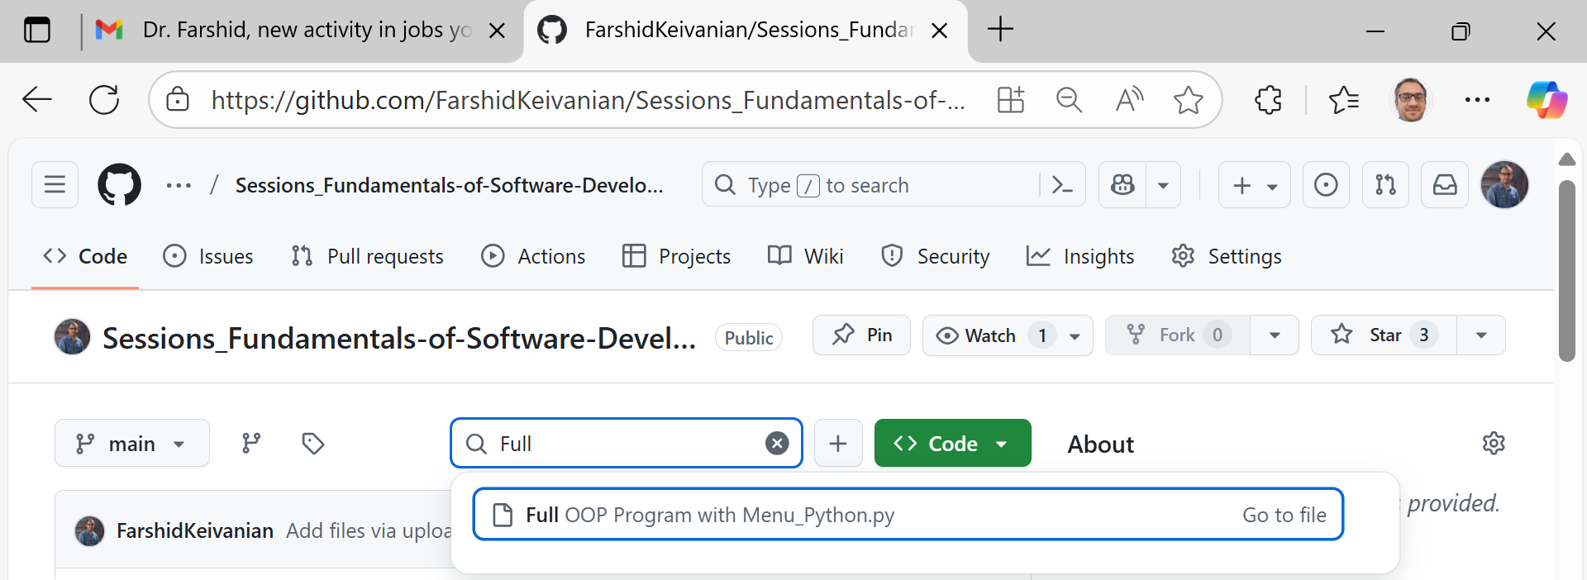
Python Example 7: Full OOP Program with Menu (Encapsulation, Inheritance, Abstraction, Polymorphism, Design Rules)
Full OOP Program with Menu_Python.py

Slide 96
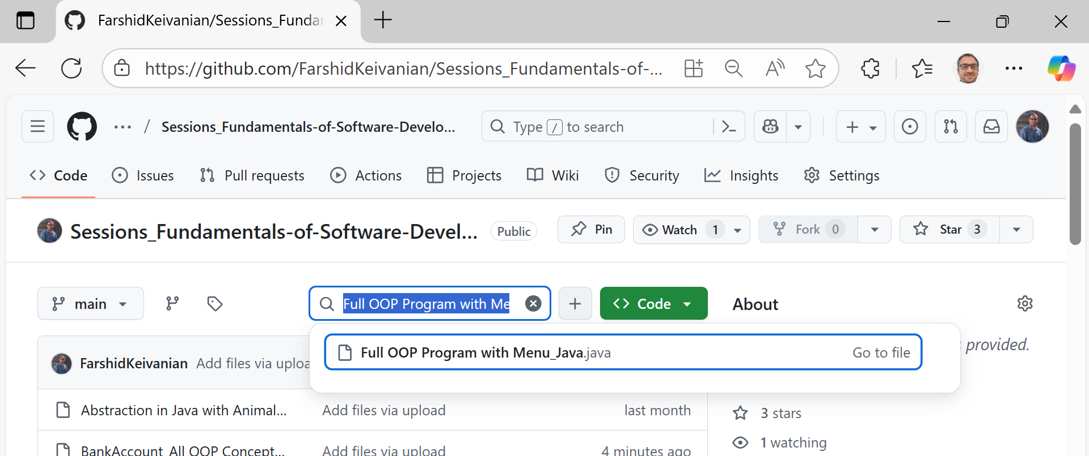
Java Example 7: Full OOP Program with Menu (Encapsulation, Inheritance, Abstraction, Polymorphism, Design Rules)
Full OOP Program with Menu_Java.java

Slide 97
Hands-On Activity 6 (Python): Extend the Full OOP Program with Menu
Task Extend the Bank Menu system so the user can choose between creating a SavingsAccount or a CheckingAccount at the start.
Both accounts must support deposit, withdraw, and show balance.
Only SavingsAccount should have the add_interest() option.
Test deposit/withdraw on both account types from the menu.

Slide 98
Hands-On Activity 6 (Python): Extend the Full OOP Program with Menu
Python Hints
Add CheckingAccount class
class CheckingAccount(BankAccount):
def __init__(self, account_number, balance):
super().__init__(balance)
self.account_number = account_number
def withdraw(self, amount):
self._balance -= amount # may go negative
print("Checking withdrawal (may go negative).")

Slide 99
Hands-On Activity 6 (Python): Extend the Full OOP Program with Menu
Modify the menu() function
Ask the user: Do you want Savings or Checking?
Create the chosen account type.
Add the add_interest() option only if it’s a SavingsAccount.
Test
Try deposit and withdraw with both account types.
Check the balance after each action.

Slide 100
Hands-On Activity 6 (Python): Extend the Full OOP Program with Menu
Java Hints
Add CheckingAccount class
class CheckingAccount extends BankAccount {
private String accountNumber;
CheckingAccount(String accountNumber, double balance) {
super(balance);
this.accountNumber = accountNumber;
}
@Override
public void withdraw(double amount) {
balance -= amount; // may go negative
System.out.println("Checking withdrawal (may go negative).");
}
public String getAccountNumber() {
return accountNumber;
}
}

Slide 101
Hands-On Activity 6 (Python): Extend the Full OOP Program with Menu
Modify the Main menu
Ask the user which type of account to create.
Use if or switch to create either a SavingsAccount or CheckingAccount.
Add an extra option for interest only when using SavingsAccount.
Test
Run the menu, choose Savings → try deposit, withdraw, add interest.
Run again, choose Checking → try deposit, withdraw (balance may go negative).

Slide 102
Hands-On Activity 6 (Python): Extend the Full OOP Program with Menu
This activity reinforces:
Encapsulation (balance stays hidden).
Inheritance (both account types reuse BankAccount).
Abstraction (withdraw must be implemented).
Polymorphism (withdraw behaves differently).
Design Rules (put add_interest() only in SavingsAccount).
Menu Pattern (central user interaction).

Slide 103

Happy Learning and Bright Futures Ahead! Dr. Farshid Keivanian Stay Connected: linkedin.com/in/farshid-keivanian github.com/FarshidKeivanian
Education is the most powerful weapon you can use to change the world. — Nelson Mandela

